Slide 1
Digital Security Services
Capability & Service Offerings Overview

Slide 2





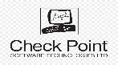


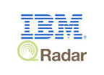









Digital Security Services
Service Offerings
Skills
A team size of 500+ with more than 100+ Minds certified in industry leading standards
Digital Identity & Access Management Services
Cyber Threat Management & Operations
Application Security & Vulnerability Management Services
Governance Risk & Compliance Services
Cloud Security Services
Enablers
COE¹ and Technical Advisory
Project Management and Governance
Active Projects
59 across multiple security disciplines
Technologies Supported
Cyber Security Platforms
MSecure
MSOC

Slide 3
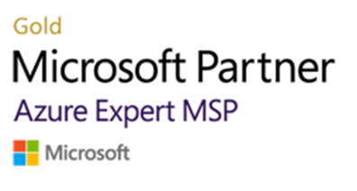
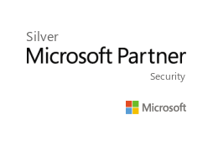
Digital Security Capabilities
Digital Identity & Access Management
Cyber Threat Management & Operations
Identity Governance & Access Management
Privileged Access Management
NextGen Security Operations
Managed Threat Detection and Response(MDR)
Consulting
Vulnerability Management & Application Security
e Digital Security
Cloud Security
Implementation
Risk based Vulnerability Management
Vulnerability Assessment & Penetration Testing
Cloud Security Posture Assessment
Continuous Cloud Workload Protection
Cyber Resilience and Accelerated Recovery
Managed Services
Application Security Testing
Governance, Risk & Compliance
Protect identities and manage access
GRC Integration & Orchestration
Policy & Compliance Management
Data Governance & Protection
Stop threats with integrated, automated protection
A team size of
550+
Secure your apps and resources across clouds
47
Active projects across multiple security disciplines
Remediate Risks & Simplify Compliance

Slide 4
Platform led approach to address Cybersecurity
External Attack Surface Management
Know your external exposure
Understand your adversaries
Passive Attack Surface Discovery
Active Validation
Continuous Monitoring
Integrated Cloud Security Posture and Workload Protection platform
Deep Cloud Visibility
Optimize Cloud Security
Configuration Compliance
Container & Workload Security
Cloud API and User Activity
Vulnerability Discovery
MSOC – NextGen Security Operations
Operationalize Zero Trust
Security Enforcement
Integration & Continuous Automation
Threat Management & Incident Response
Cloud based SIEM (Microsoft Azure Sentinel)
Managed Offerings
Data Protection and ransomware recovery
Threat Intelligence

Slide 5
MSOC - Managed Detection and Response Services
24x7 Security incident management
Signature & Rule-based detection
User-behavior analysis
Custom rules, dashboards and reports
Alert enrichment & tuning
Open-source, commercial & private threat feeds
Threat analytics and actionable intelligence
Integration and enrichment
Threat advisory & reporting
Dark web monitoring
On-demand malware analysis
Malware post-mortem forensics
Malware identification and profiling
Memory forensics
Workflow identification & orchestration
Playbook development & management
Integration & response automation
Basic threat hunting
Advance threat hunting
Root-cause, kill chain and Mitre att&ck analysis
Use case development & management
Use case enhancement & tuningre
Cyber Threat Detection
Cyber Threat Response
Cyber Threat Hunting
Use Case Engineering
Malware Analysis
Cyber Threat Intelligence

Slide 6





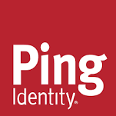

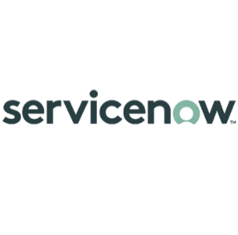


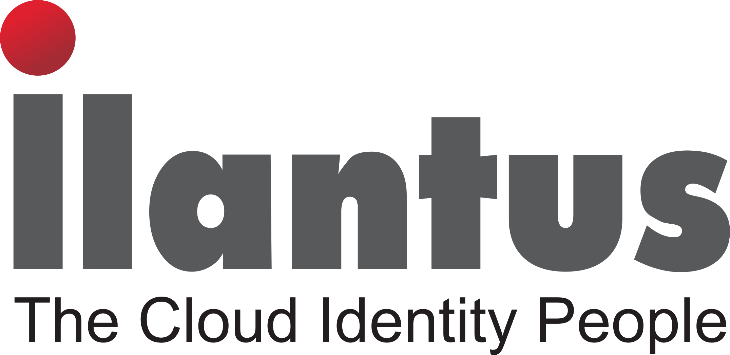
Digital Identity & Access Management – Service Offerings
IAM Consult
IAM Engineering
Managed Services
Architecture & Design
Deployment Services
Application Onboarding
Operations & Support
IGA
MFA
SSO
PAM
PIM
Analytics
Automation

Slide 7
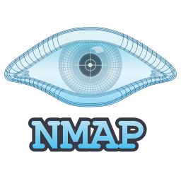
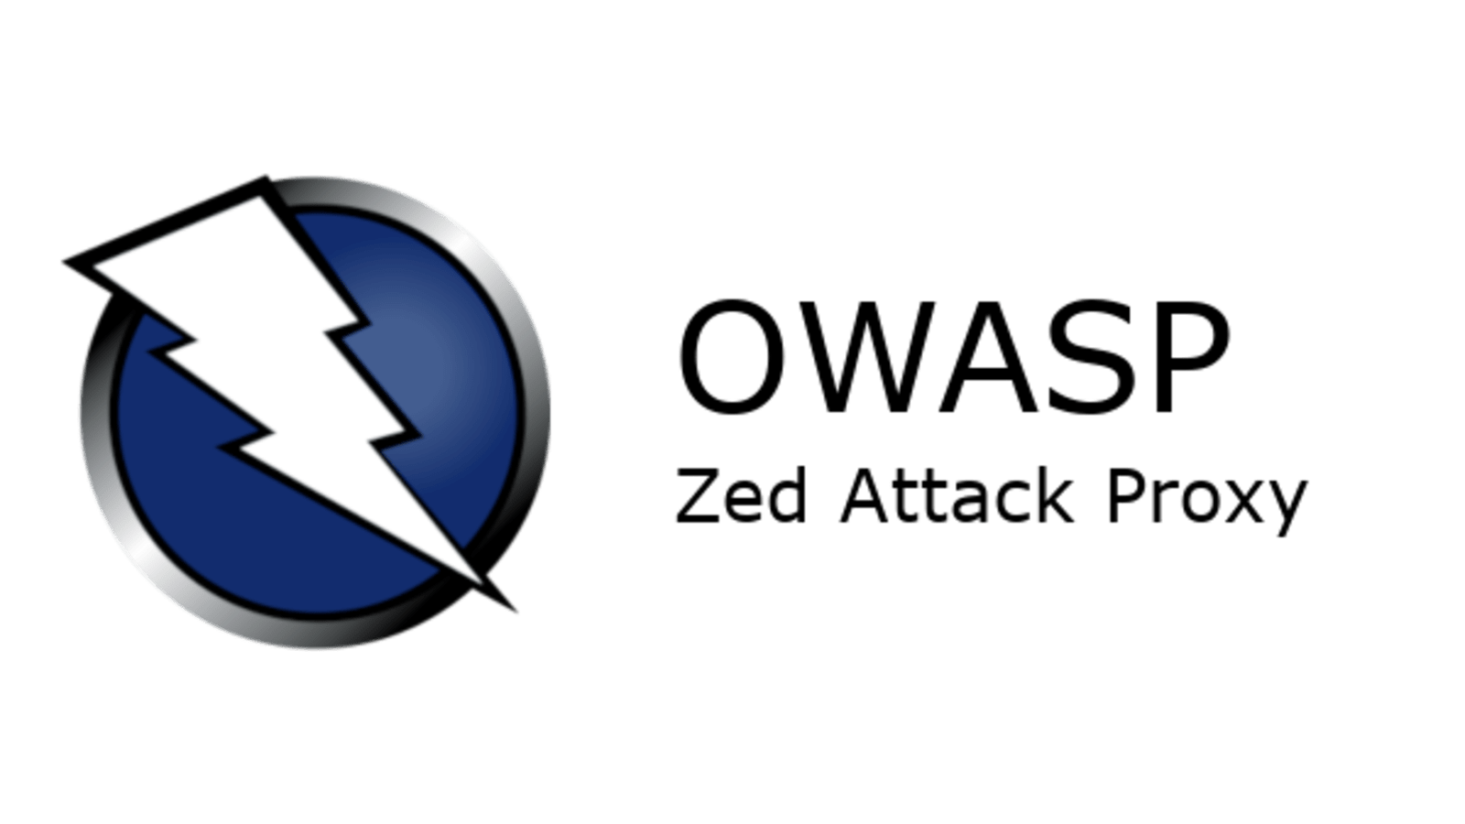
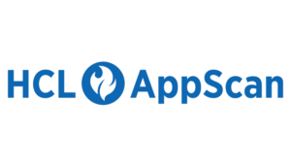
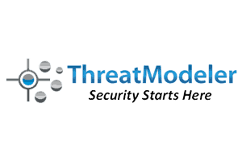









Vulnerability Management – Service Offerings
VM Consult
VM Assessments
VM Managed Services
Vulnerability Program Management & Strategy
Application Security
Remediation Analysis & support
Remediation Support
DevSecOps Platform Strategy
DAST
SAST
Threat Modeling
Penetration Testing
Red Teaming Services
Web Applications
API Security

Slide 8

GRC– Service Offerings
GRC Consulting
GRC Automation
Managed Services
Automation Strategy & Roadmap
Assessments & Advisory
Engineering & support
GRC Managed Services
CISO Advisory
ISO 27001 Implementation
IT Risk Assessments
Cyber Resiliency Assessments
Supplier Risk Assessments
Compliance Assessments – NIST, CIS, FFIEC, NYDFS, PCI, HIPAA, HITRUST, GDPR

Slide 9

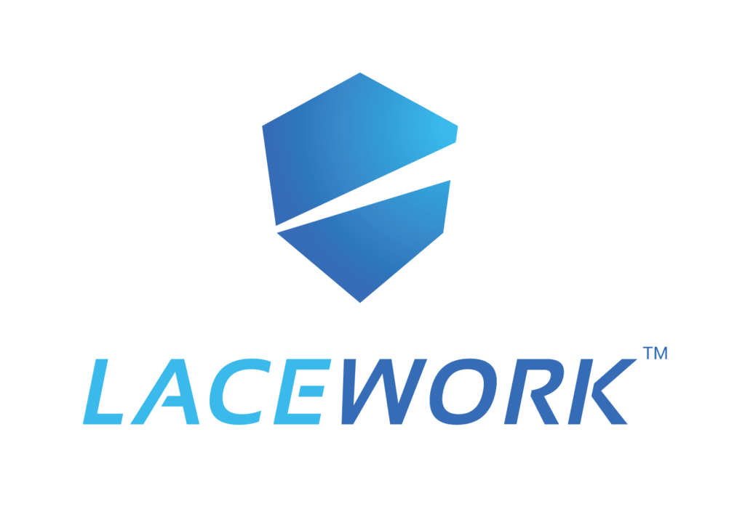




Cloud Security – Service Offerings
Cloud Consulting
Cloud Security Engineering
Cloud Security Operations
Cloud Strategy & Assessments
Cloud First Native Security Controls
Cloud Security Architecture & Automation
Multi Cloud Security Operations & Support
Configuration & Vulnerability Management
Metrics & Reporting
Security & SIEM
Incident Response
Threat Intelligence
Network Security, Cloud Access SSO & Federation, Privileged Identity & Access Management

Slide 10


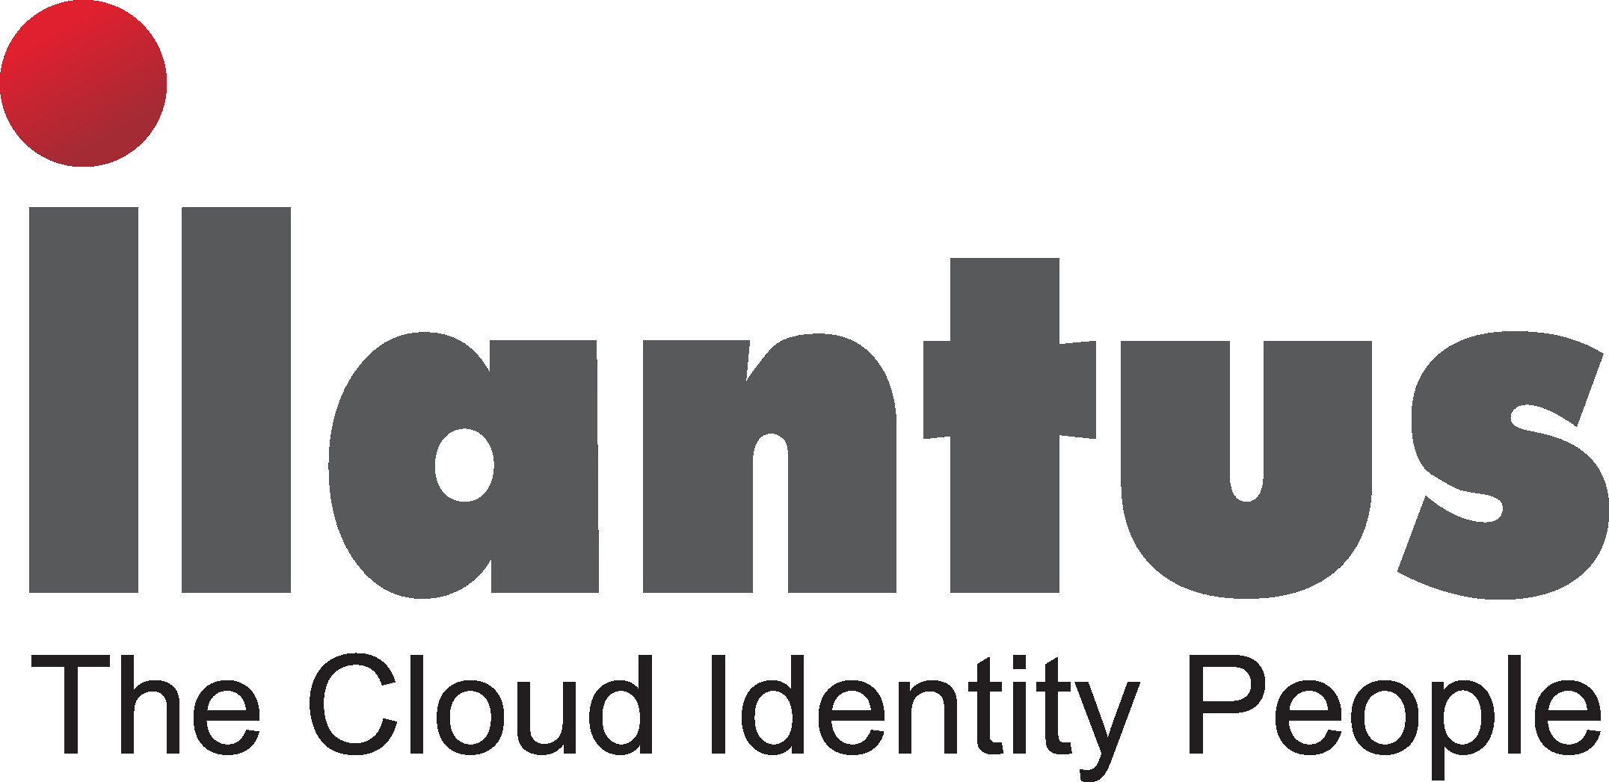













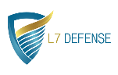

Digital Security – Partner Ecosystem
Cloud Security
Azure Security Offerings
Cloud Security Assessment and DDOS, WAF
Securing Application and Linux workload
Cloud Security
Cloud Security
Cloud Security
Zero Trust & Segmentation
Identity & Access Management
IDAM
PIM
Converged IAM
Customer IAM
SSO
SSO
IDAM
Application Security and Vulnerability
Vulnerability Management
DevSecOps
Vulnerability Management
Application Security
Application Security
External Attack Surface Management
Vulnerability Mgmt. & Application Security
Cyber Threat Management & Operations
(MSSP)-SOC and other Security Products
Managed Detection and Response
SIEM
SIEM
API and IoT Security
API Security / WAF
SOAR and GRC
Governance Risk and Compliance
- Emerging Partners

